Slide 1
FIRE FIGHTER Service

Slide 2
Team Member’s
Meher Nigar – 19201043
Rifa Tasfia - 19201045
Asikur Rahman Sumon- 19201055

Slide 3
Fire Fighter Service
Increase last two decades
Occar around 285000 fires
Country loss Tk6,900 core
unplanned urbanization, the violation of rules for constructing buildings
https://www.thefinancialexpress.com.bd/national/fire-incidents-increase-four-fold-to-285000-in-two-decades-1636801072

Slide 4
Motivation
Densely populated country.
can’t take early actions. So we need an online platform so that we can reduce this loss.

Slide 5
Objective
1.People become panic.
2.Give wrong addresses.
3.conversation cannot be heard properly.
Here we are different.
1.write the user his phone number address.
2.our team from the station..

Slide 6
Service Solution
Build an online solution for Fire Station.
See nearest fire station.
How fare service from them.

Slide 7
Service Output
From this project we can use an online platform for Fire Services where general people can see the nearest fire station and their basic information and can call.

Slide 8
Impact on Society:
Last two decades we lost Tk6,900 corer and 24074 people.
https://www.thefinancialexpress.com.bd/national/fire-incidents-increase-four-fold-to-285000-in-two-decades-1636801072

Slide 9
Critical Challenges
collect fire station location
algorithm to find out nearest fire station service.

Slide 10
Service Functionality
Admin
Dashboard
User
Username,Password
Admin dashboard
Log in
Online Fire Report
View Status
Home
Name, Mobile no. Location. Message
Enter name,Mobile no.Location
Reporting,view status,admin login

Slide 11
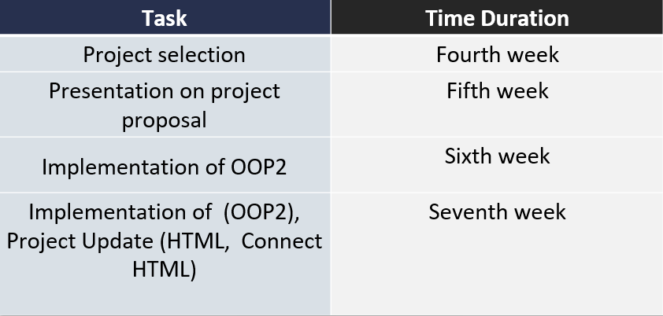
Project Management

Slide 12




Necessary Tools
01
02
1
04
CSS, Bootstrap
Html ,Js
Python
Django

Slide 13
Complex Engineering Problem Solving
Knowledges
Problems
Activities

Slide 14
Knowledges
K3
K6
K1
K5
Engineering Fundaments
Design
Technology
Natural Science
Natural sciences applicable in this project.
Programming Knowledges
Html , Css, Bootstrap
Framework in python language (Django)

Slide 15
Knowledges
K7
K8
Society
Research
Decreased death people rate (as a firefighter ,as a normal people.
Feasibility Research

Slide 16
Problems
P1
P3
P5
P7
Depth of Knowledge Required
Depth of Analysis Required
Extent of applicable codes
Interdependence
Study of all existing firefighter website(K8), user, monitoring authority(K3),backend frontend design(K5,K6).
Depth of analysis of requirements from user, monitoring authority is needed to ensure user satisfaction.
Required to analyze and implement various programming knowledge and skills.
Our project involves requirement analysis, designing back-end, front-end, software testing, etc.

Slide 17
Activities
A1
A2
P3
Ranges of Resources
Level of interaction
Innovation
Our project needs to engage diverse resources including various functional tools
A good level of interaction is needed among the user and admin.
Our platfrom needs to be updated with innovative and creative ideas to meet new features for all user.

Slide 18
Thank You

